Slide 1
DATA SCIENCE BOOTCAMP
(24 week session)
Copyright © 2020 Exceed Philippines. All rights reserved

Slide 2
NAME
COURSE AND YEAR LEVEL/JOB TITLE
WHY ARE YOU HERE?
EXPECTATIONS FOR THIS BOOTCAMP
Copyright © 2020 Exceed Philippines. All rights reserved

Slide 3
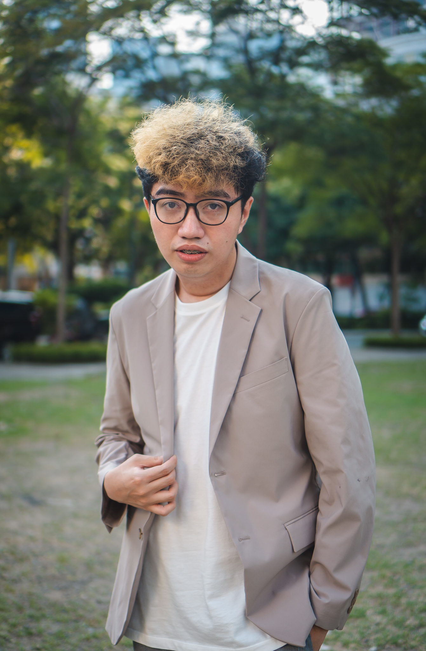

Hello!!
I’m AJ
Co-founder of Exceed Philippines
Still a certified teacher by heart!
I like taking pictures and video editing
Watching Anime, Kdrama and American Series
Copyright © 2020 Exceed Philippines. All rights reserved

Slide 4
ABOUT ME
2015
Cum Laude | STI OrCa
Java Developer
Associate Professor | STI Orca
Data Scientist | Accenture
Sr. Data Scientist | Globe Telecom (Yondu, Inc)
Chief Data Scientist | Betterteem Technologies
Data Scientist | Boom AI
2018
2021
2022
Copyright © 2020 Exceed Philippines. All rights reserved

Slide 5
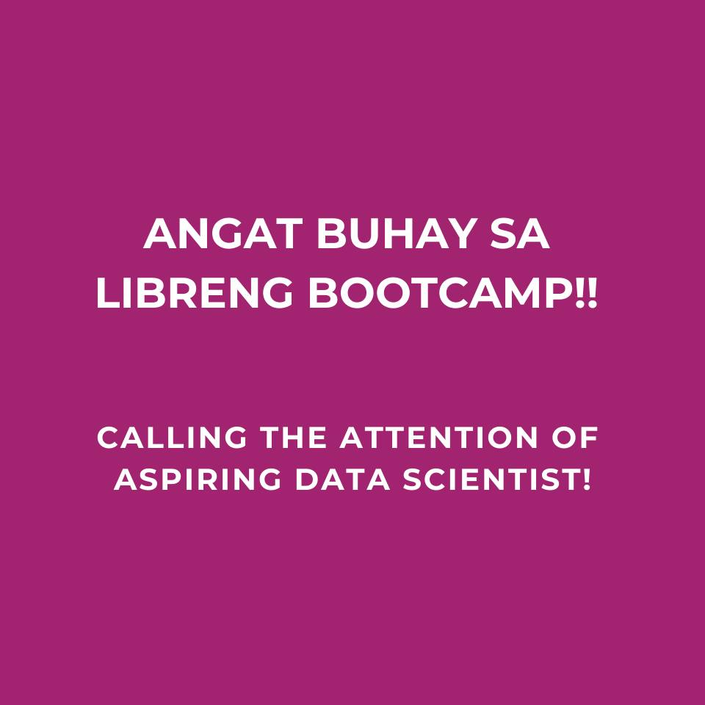

30K-1M
Copyright © 2020 Exceed Philippines. All rights reserved

Slide 6
WHY CONDUCT IT FOR FREE?
Copyright © 2020 Exceed Philippines. All rights reserved

Slide 7



I will vote for Myla!
-A College Student
INFORMATION ATTACK!!!
MACHINE
LEARNING
RESULTS
BAD
POSTS
GOOD
POSTS
I will now vote for Rhalp!
-A College Student
Copyright © 2020 Exceed Philippines. All rights reserved

Slide 8

JUPYTER: JUlia, PYthon, and R
Copyright © 2020 Exceed Philippines. All rights reserved

Slide 9
QUESTIONS?
Copyright © 2020 Exceed Philippines. All rights reserved

